Slide 1
ByteSTM Java Software Transactional Memory at the Virtual Machine Level
Presented By:
Mohamed Mohamedin
Committee Members:
Binoy Ravindran, Chair
Leyla Nazhandali
Mohamed Rizk
Paul E. Plassmann
Master of Science in Computer Engineering
Electrical & Computer Engineering Department
Virginia Polytechnic Institute and State University

Slide 2
Outline
Concurrency Control
Transactional Memory
Software Transactional Memory
Contribution
ByteSTM
Related Work
Experimental Results.
Conclusion and Future Work

Slide 3
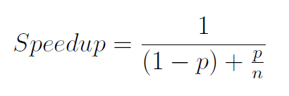
Concurrency Control (1)
Multicore age
Amdahl's law [6]
Speedup
p

Slide 4
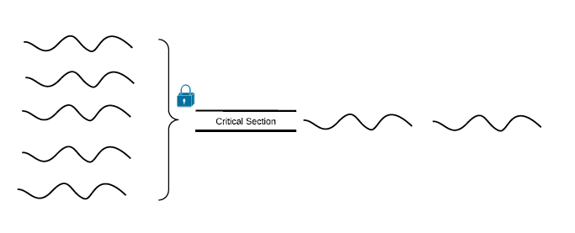
Concurrency Control (2)
Lock-based synchronization
Coarse-grained locking
Fine-grained locking
Locks problems
Deadlocks, livelocks, lock-convoying, priority inversion, non-composable

Slide 5
Coarse vs. Fine Grained Locking
public boolean add(int item) {
Node pred, curr;
lock.lock();
try {
pred = head;
curr = pred.next;
while (curr.val < item) {
pred = curr;
curr = curr.next;
}
if (item == curr.val) {
return false;
} else {
Node node = new Node(item);
node.next = curr;
pred.next = node;
return true;
}
} finally {
lock.unlock();
}
}
public boolean add(int item) {
head.lock();
Node pred = head;
try {
Node curr = pred.next;
curr.lock();
try {
while (curr.val < item) {
pred.unlock();
pred = curr;
curr = curr.next;
curr.lock();
}
if (curr.key == key) {
return false;
}
Node newNode = new Node(item);
newNode.next = curr;
pred.next = newNode;
return true;
} finally {
curr.unlock();
}
} finally {
pred.unlock();
}
}

Slide 6
Concurrency Control (3)
Lock-free synchronization
public boolean add(int item) {
while (true) {
Node pred = null, curr = null, succ = null;
boolean[] marked = {false}; boolean snip;
retry: while (true) {
pred = head; curr = pred.next.getReference();
while (true) {
succ = curr.next.get(marked);
while (marked[0]) {
snip = pred.next.compareAndSet(curr, succ, false, false);
if (!snip) continue retry;
curr = succ; succ = curr.next.get(marked);
}
if (curr.val < item)
pred = curr; curr = succ;
}
}
if (curr.val == item) { return false;
} else {
Node node = new Node(item);
node.next = new AtomicMarkableReference(curr, false);
if (pred.next.compareAndSet(curr, node, false, false)) {return true;}
}
}
}

Slide 7
Transactional Memory
Like database transactions
ACID properties
Easier to program
Fine-grained performance
Composable
public boolean add(int item) {
Node pred, curr;
atomic {
pred = head;
curr = pred.next;
while (curr.val < item) {
pred = curr;
curr = curr.next;
}
if (item == curr.val) {
return false;
} else {
Node node = new Node(item);
node.next = curr;
pred.next = node;
return true;
}
}

Slide 8
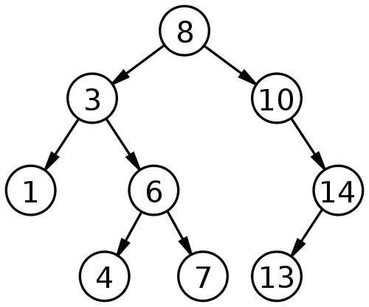
How TM works?
Optimistic concurrency
Example: Adding 9 & 15 concurrently

Slide 9
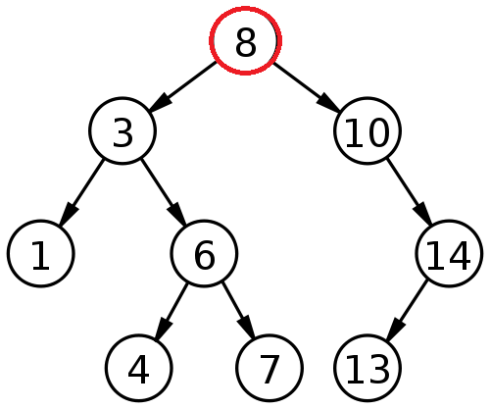
Thread A adds 9 & Thread B adds 15
Thread A
Read-set: 8
Write-set:
Thread B
Read-set: 8
Write-set:

Slide 10
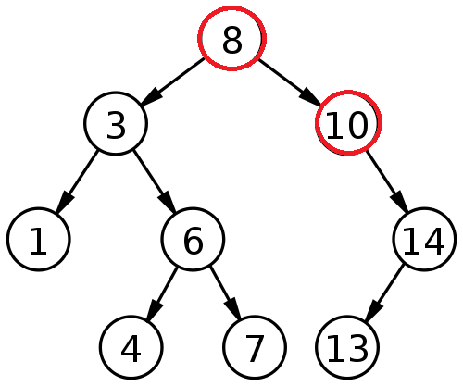
Thread A adds 9 & Thread B adds 15
Thread A
Read-set: 8, 10
Write-set:
Thread B
Read-set: 8, 10
Write-set:

Slide 11
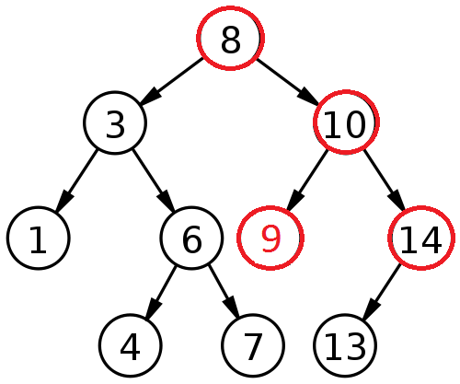
Thread A adds 9 & Thread B adds 15
Thread A
Read-set: 8, 10
Write-set: 10 (left child pointer)
Thread B
Read-set: 8, 10, 14
Write-set:

Slide 12
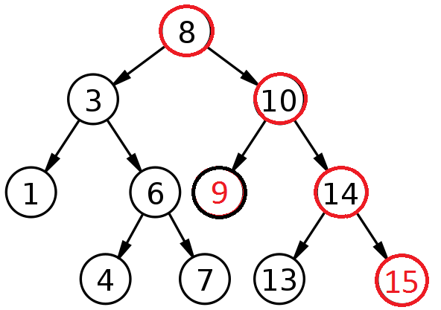
Thread A adds 9 & Thread B adds 15
Thread A
Read-set: 8, 10
Write-set: 10 (left child pointer)
Committed successfully
Thread B
Read-set: 8, 10, 14
Write-set: 14 (right child pointer)

Slide 13
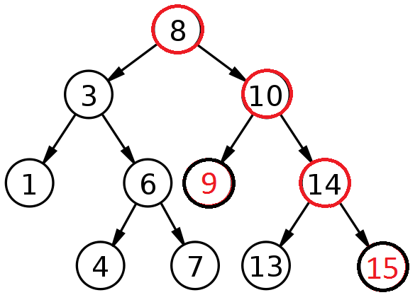
Thread A adds 9 & Thread B adds 15
Thread A
Read-set: 8, 10
Write-set: 10 (left child pointer)
Committed successfully
Thread B
Read-set: 8, 10, 14
Write-set: 14 (right child pointer)
Committed successfully

Slide 14
Object-based granularity
Thread A
Read-set: 8, 10
Write-set: 10
Committed successfully
Thread B
Read-set: 8, 10, 14
Write-set: 14
Conflict ➔ Abort
WAR

Slide 15
Transactional Memory
HTM [45, 39, 7, 92, 21,19]
Best performance
Limited in size & time
STM [86, 98, 80, 55, 49]
Entirely in software
Not limited and flexible
Higher overhead
HyTM [57, 76, 24, 68, 102]
HTM+STM

Slide 16
Software Transactional Memory (STM)
Library-based
No change to the language
Explicit transactions [43, 33, 72, 99]
Implicit transactions [16, 81, 55]
Compiler-based [52, 49]
Adds new language constructs
Implicit transactions
Virtual Machine-based [40, 18, 100, 2]
Rare & not well studied

Slide 17
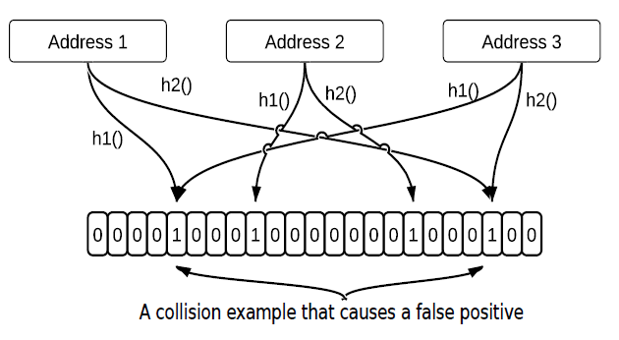
RingSTM [91]
Lazy versioning (Redo log)
Lazy validation
Opacity [37]
Uses Bloom filter [11] signatures

Slide 18
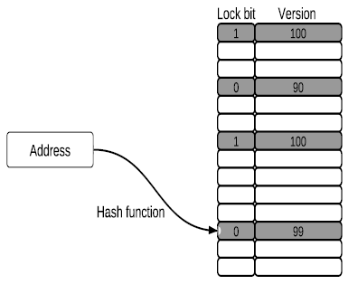
TL2 [25]
Lazy versioning (Redo log)
Lazy validation
Opacity
Global clock & Versioned lock table

Slide 19
VM-based STM
Is changing the VM acceptable?
Atomos [18]
ByteSTM and others
Benefits
Direct memory access
Full control over garbage collector (GC)
Full control over bytecode instructions behavior
Can manipulate thread’s header
HTM compatible

Slide 20
Contribution
ByteSTM
VM-level STM
Superior performance
Implicit transactions
No instrumentation
Works on all data types
Supports external libraries
Atomic blocks anywhere in the code
Direct memory access
Metadata in the thread header
Field based granularity
No GC overhead

Slide 21
ByteSTM
Implicit transaction
atomic{
A = B;
B++;
}
Or:
stm.STM.xBegin();
A = B;
B++;
stm.STM.xCommit();
Implicit transaction
Transaction T;
T.begin()
do{
A.txWrite(B.txRead());
B.txWrite(B.txRead() + 1);
}while( ! T.commit());
Explicit transaction

Slide 22
ByteSTM
No instrumentation
Bytecode instructions have two modes
Transactional
Non-transactional
Faster
One copy of the code.
Works on all data types
Memory access is monitored at the bytecode instructions level
Supports external libraries

Slide 23
ByteSTM
Atomic blocks anywhere in the code
Saves program state at transaction start
Restore the save state when transaction aborted
Monitor less objects
int c=10;
c = a + 5;
atomic{
c = c / 2;
a = c;
}
@Atomic
void method(int c){
c = c / 2;
a = c
}

Slide 24
ByteSTM
Memory model
Direct memory access
Faster write back
Absolute address + raw memory model
One code to handle all cases
Instance field: Object address + field offset
Static field: Static memory address + field offset
Array element: Arracy address + element size x element index
Absolute address
Data Type | Abs. Address | Value | Size
int | 0x01258F00 | 20 | 4
double | 0x01258F04 | 46 | 4
Object (reference) | 0x01258F08 | 2541025 | 4
Raw memory model

Slide 25
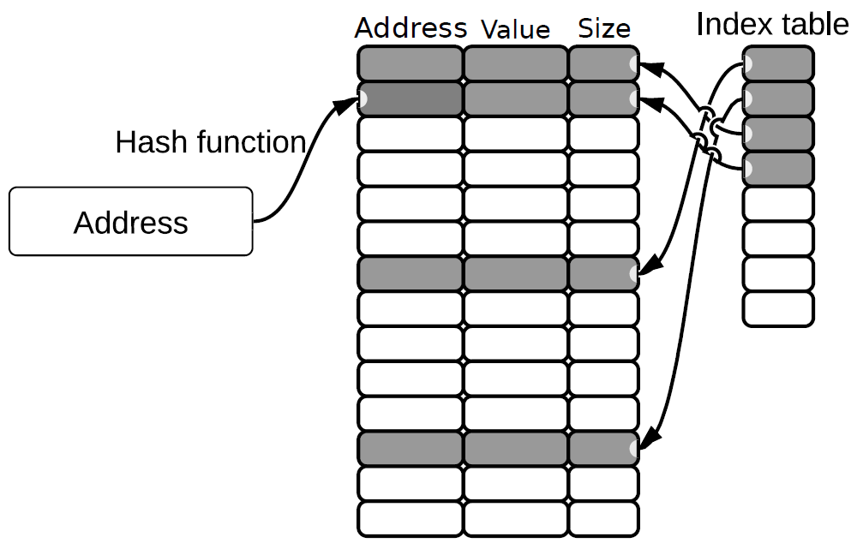
ByteSTM
Write-set
Arrays
Open Addressing Hashing

Slide 26
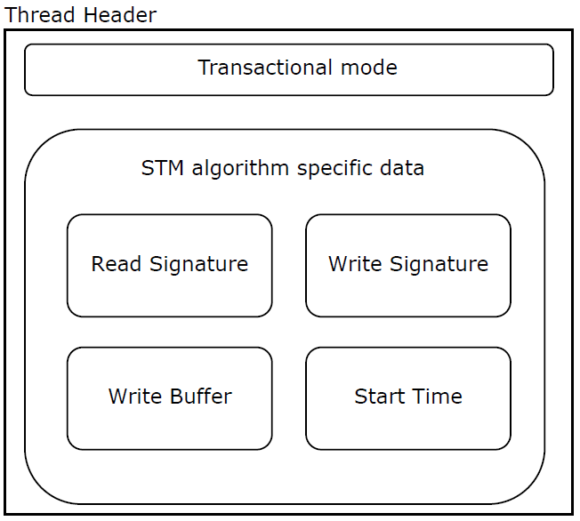
ByteSTM
Metadata in the thread header
Faster than Java standard ThreadLocal

Slide 27
ByteSTM
No GC overhead
Manually allocate and recycle memory for transactional metadata
Directly fix write-set only referenced objects

Slide 28
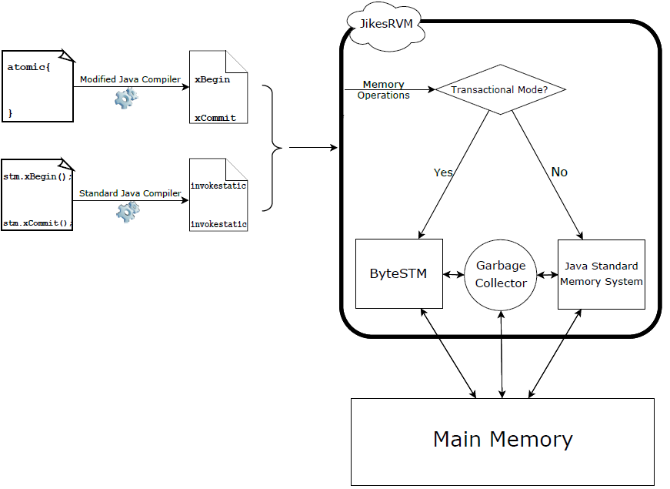
ByteSTM system architecture

Slide 29
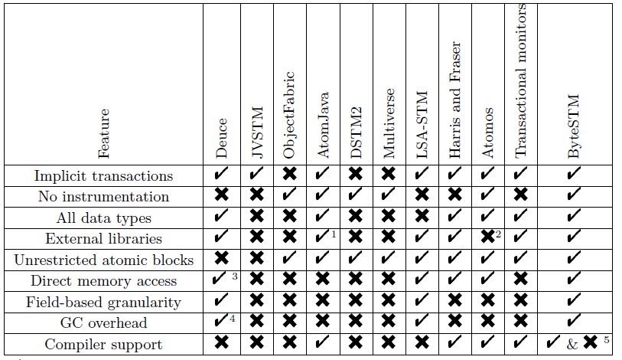
Related work
Library-based
VM-based

Slide 30
Experimental Results
Test Environment
48-core machine (four AMD Opteron with 12 cores running at 1700 MHz).
16 GB of memory.
Ubuntu Linux Server 10.04 LTS 64-bit.
JikesRVM [5]
The competitor STMs include Deuce [55], ObjectFabric [72], Multiverse [99], DSTM2 [43], and JVSTM [16].
Micro-benchmarks(Linked List, Skip List, Red-black Tree, and Hash set)
Macro-benchmarks STAMP benchmark suite [17] (Vacation, KMeans, Genome, Labyrinth and Intruder) and a Bank application.

Slide 31
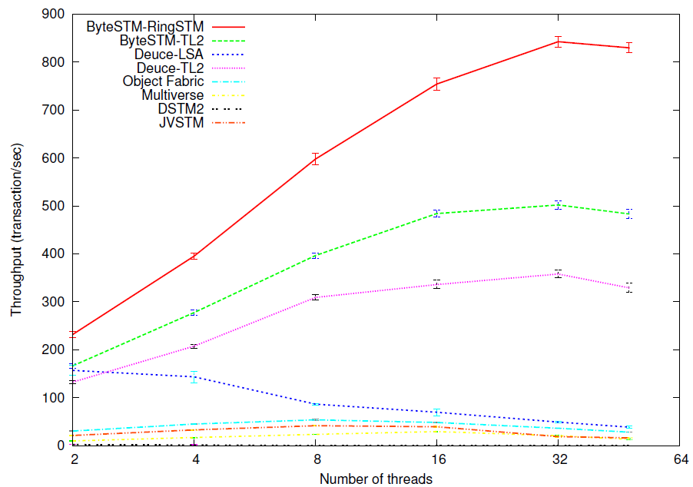
Linked List
25% - 47% (Avg. 38%)
20% writes.

Slide 32
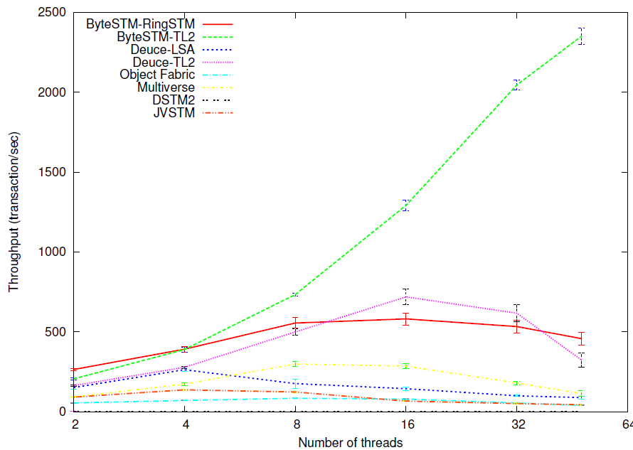
Skip List
20% - 75% (Avg. 40%)
80% writes.

Slide 33
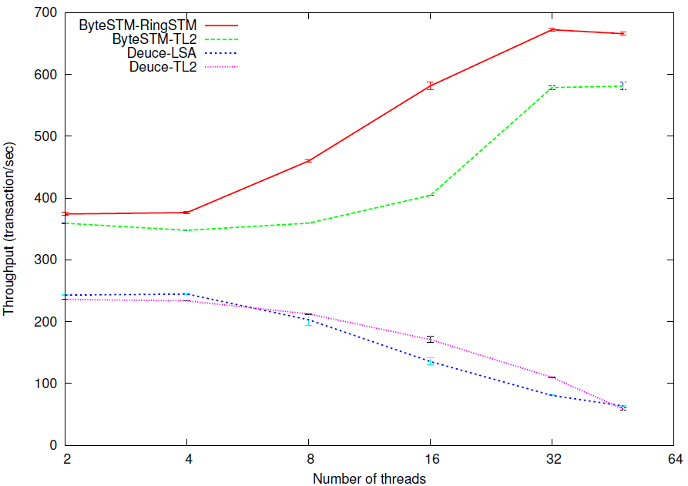
Hash Set
Average of 267%.
100% writes.

Slide 34
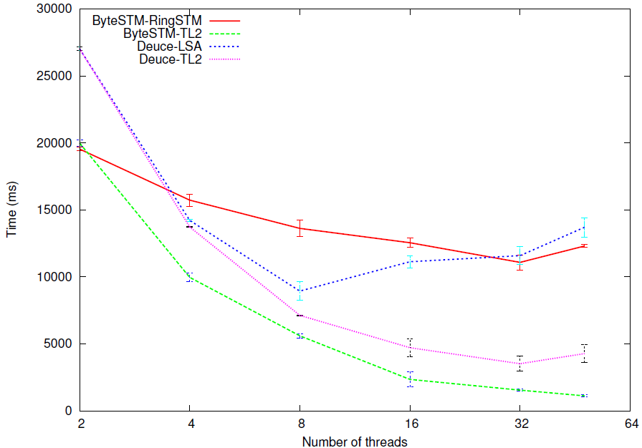
Vacation
Average of 102%.
Low contention.

Slide 35
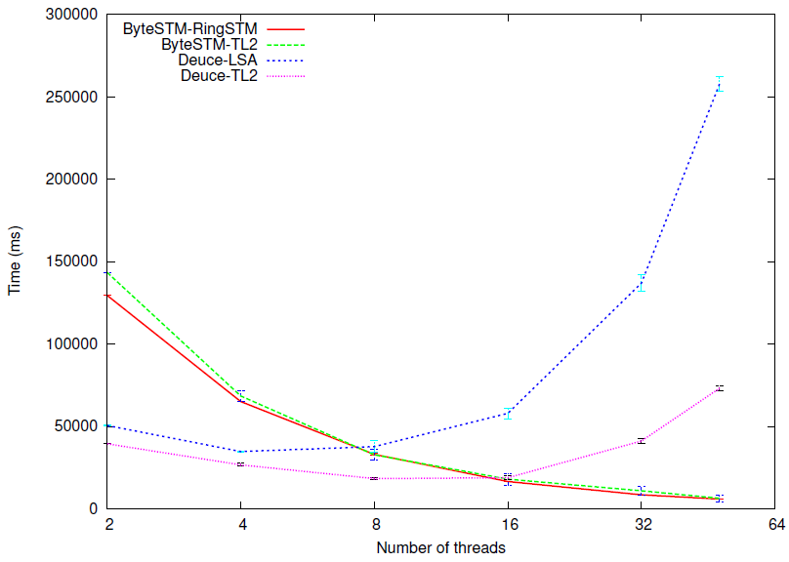
KMeans
Average of 190%

Slide 36
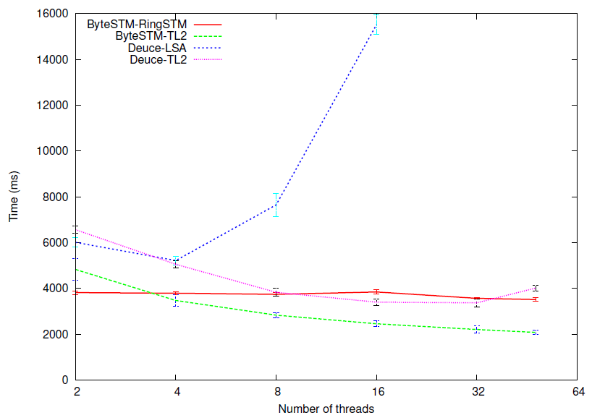
Labyrinth
Average of 50%.

Slide 37
Conclusion
Implementing a Java STM at the VM-level is indeed possible.
Yields significant performance benefits.
Micro-benchmarks: 20% to 75%.
Macro-benchmarks: 36% to 100%.

Slide 38
Future Work
Supporting advanced TM features such as nested transactions, irrevocable transactions, and strong atomicity
Evaluating ByteSTM on a more wider suite of benchmarks and other applications (e.g., STMBench7 [38], RMS-TM [54, 53], Lee-TM [8]).
Supporting plugging other STM algorithms transparently (e.g., by extending an abstract class)
Using the Jikes Optimizing Compiler [97, 5] instead of using the Jikes Baseline Compiler [96, 5] for improved performance.

Slide 39

Thanks
Questions?

